Slide 1
Web Scraping from amazon.in
Topic : One Plus 6T

Slide 2
Problem statement
To scrap all the reviews for One Plus 6T from Amazon India
To find out the sentiment of Each review
The estimate the overall Feedback rate for the One Plus 6T

Slide 3
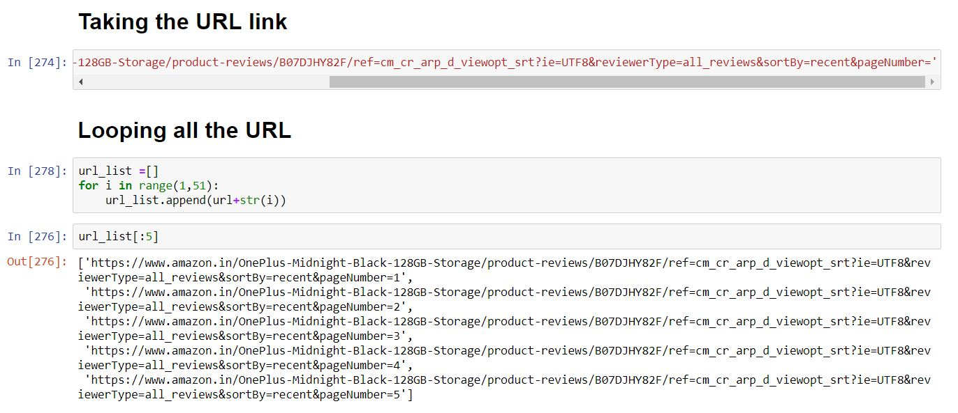
Multiple URL looping

Slide 4
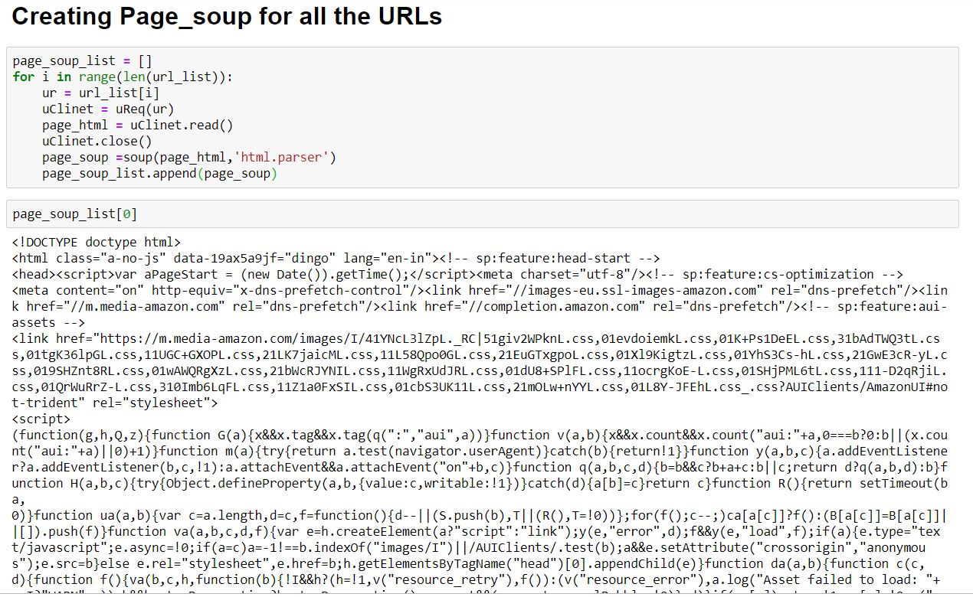
Creating Page Soup

Slide 5
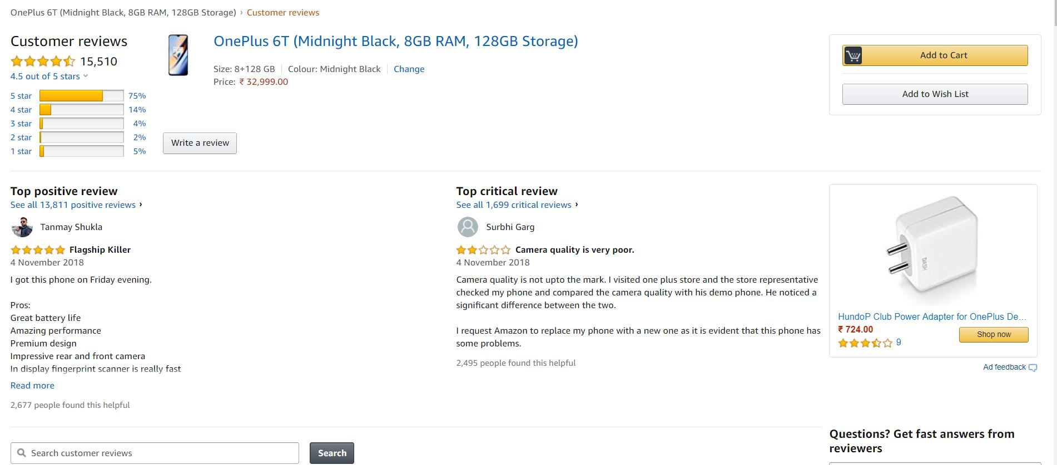
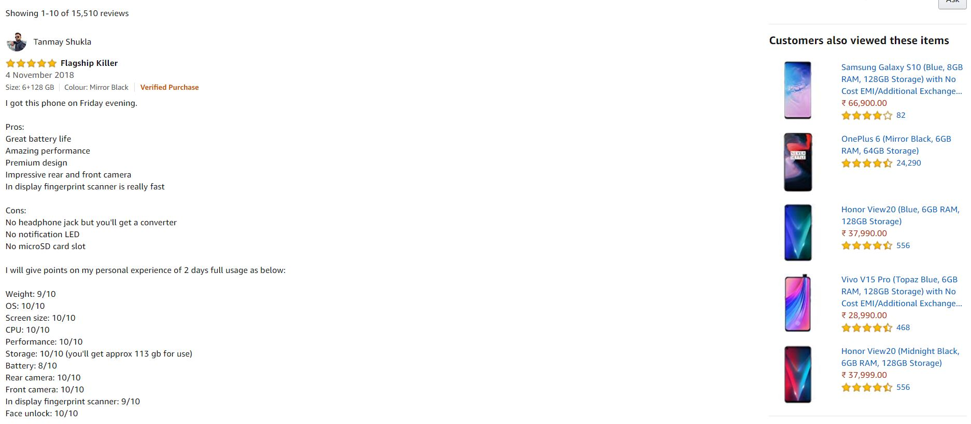
Review Page Issues

Slide 6
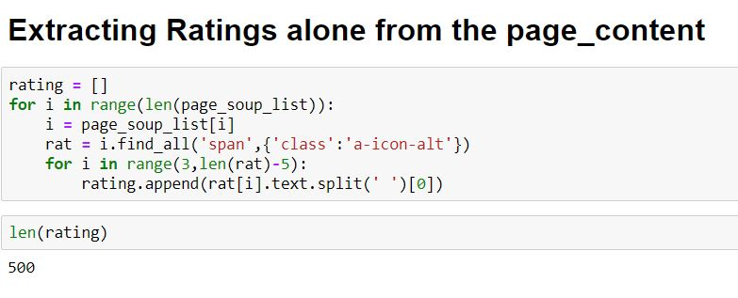
Ratings scraping

Slide 7
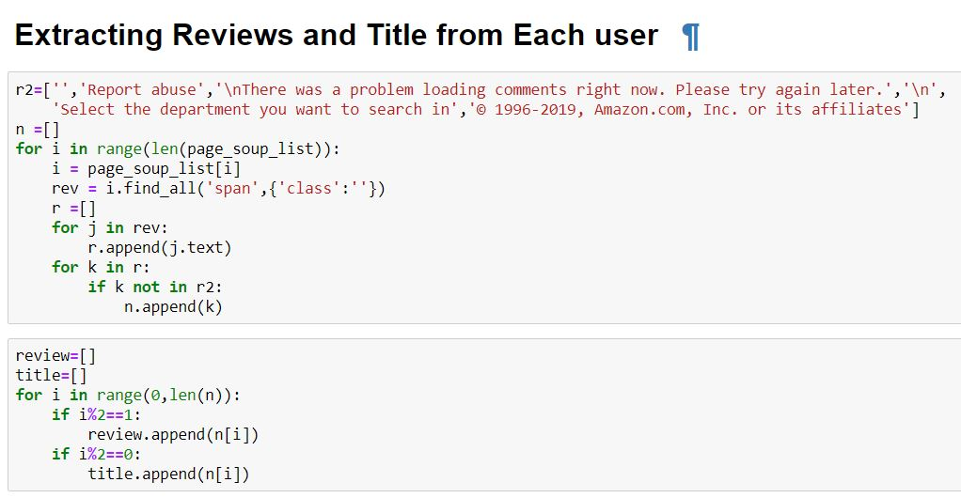

Slide 8
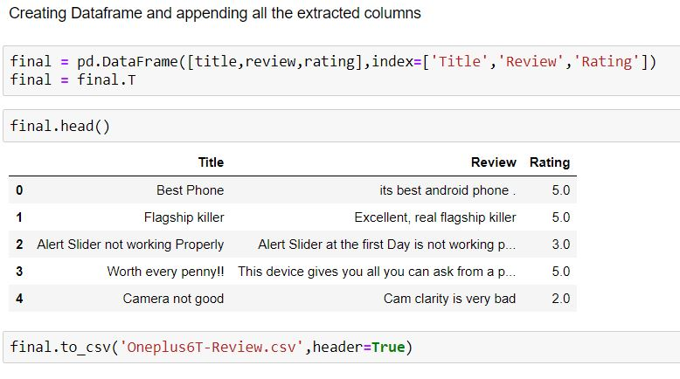
Exporting as a CSV

Slide 9
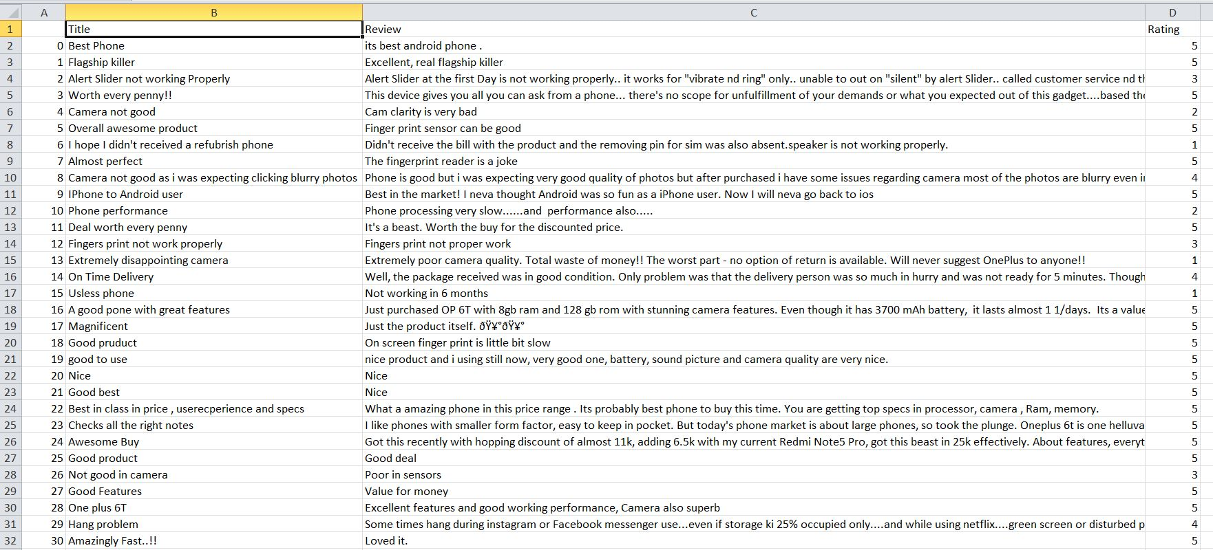
CSV sample screenshot

Slide 10
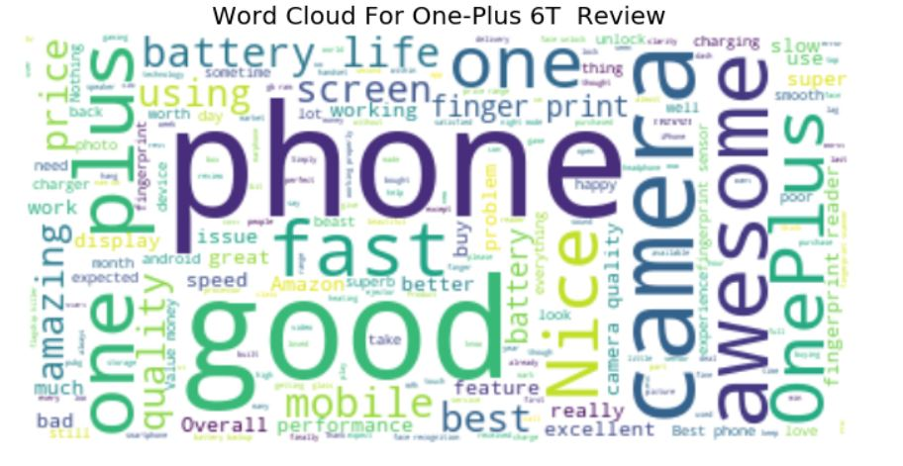
Word Cloud

Slide 11
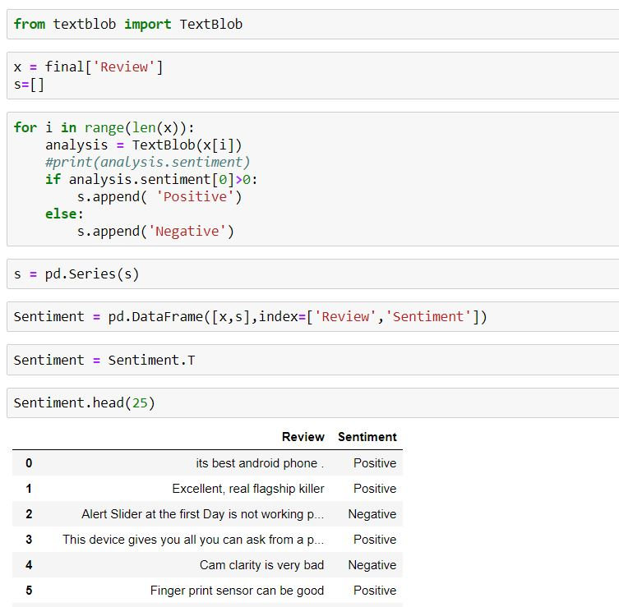
Sentiment analysis using text blob

Slide 12
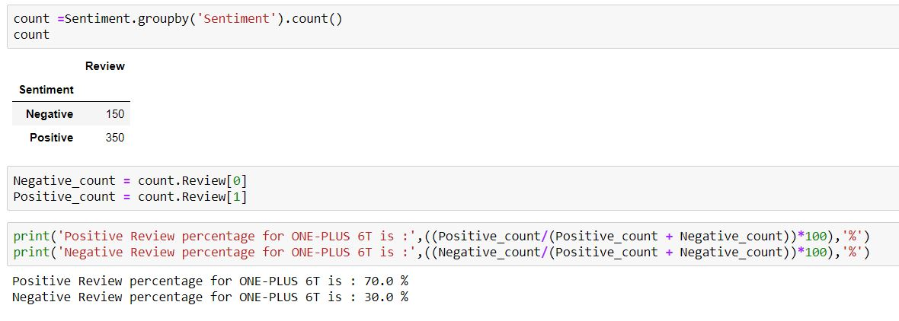
Overall Feedback Analysis

Slide 13
Thank You

